Slide 1
Printed Circuit Boards

Slide 2
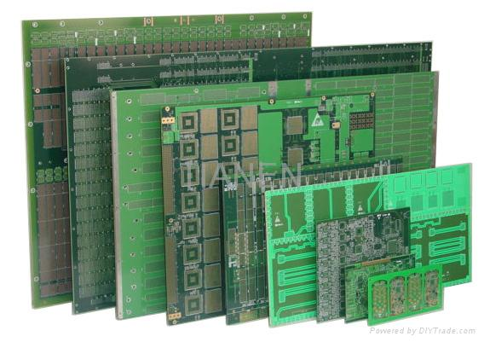
The Printed Circuit Board (PCB)
Mechanical Mounting
Electrical Connectivity
Many flavors

Slide 3
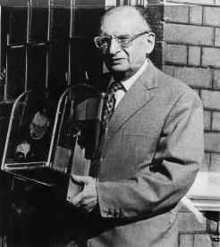
Who is this man?
Paul Eisler (1907-1995)
Invented the PCB in 1936
Used it in his radio ----→
Also invented rear-window defroster

Slide 4
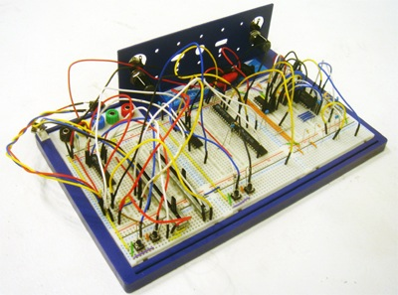
Which is better?
This???

Slide 5
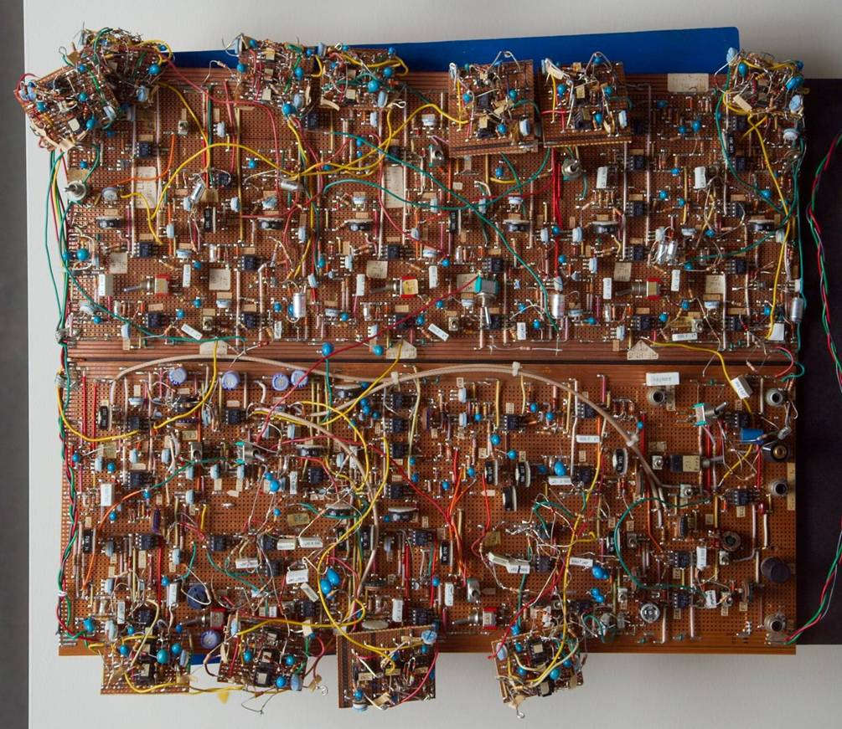
Which is Better?
This???!!!?!!

Slide 6
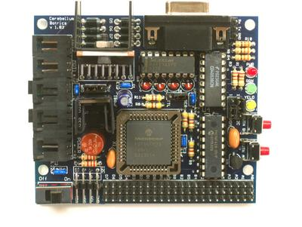
This is Better.

Slide 7
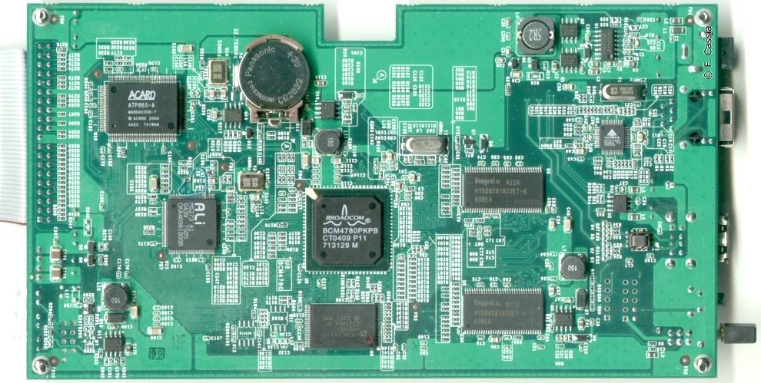
This is Even Better*.
* - see next slide

Slide 8
Through-h0le Vs. Surface Mount
Through-Hole:
Easy to solder
Easier to fix circuits
You don’t lose components on the floor
Surface Mount:
Miniaturization
  From small to ridiculous
Easier Automated Assembly
PCB Fab is easier – fewer holes to drill
Some parts are only Surface mount

Slide 9
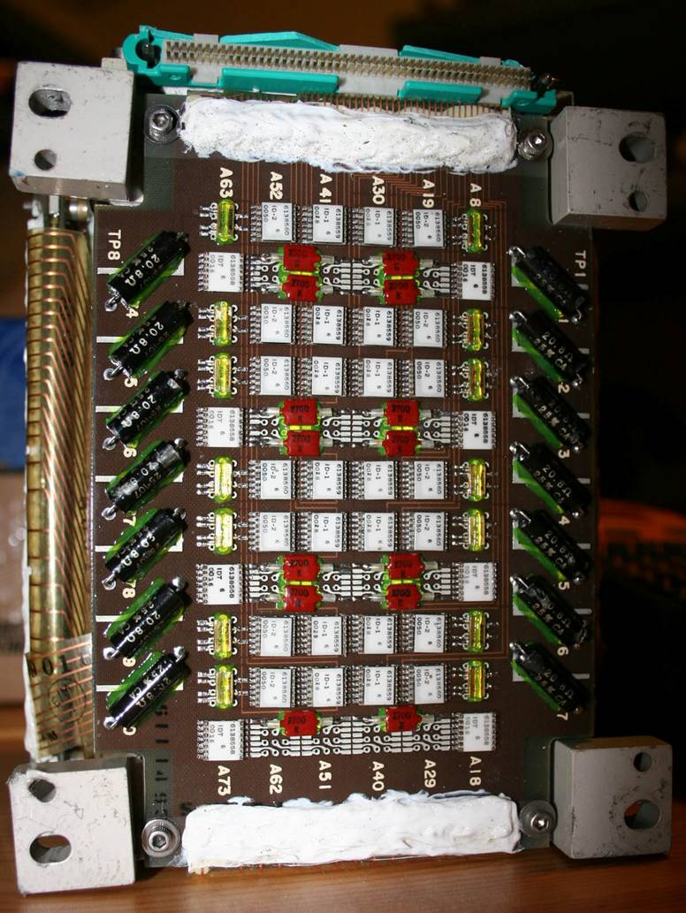
Historical Digression
First surface mount boards were developed for Saturn V flight computers
In 1964!
By IBM
This module ------------> can hold 14,336 bytes
The Saturn V had 8 of them

Slide 10
Circuit Boards are Like Onions
They have many layers
The dielectric
  Epoxy-fiberglass. Not yummy
The copper layer
The soldermask
The silkscreen
Multi-layer

Slide 11
Modern PCB Fab
Fully Automated
Fabrication steps:
  Merge dielectric and copper
  Drill holes
  Mask and etch copper
  Combine layers if making a board with inner copper layers
  Add soldermask
  Print on silkscreen

Slide 12
PCB Fab from the Gadgeteer perspective
Layout circuit board (we’ll get to this in a minute)
Create Gerber Files
Send to board house with money
  Money spent is a complicated equation based on speed, size of board, and board specs
Wait one day to several weeks for board house robots to do magic
Receive package in mail
Sometimes comes with popcorn

Slide 13
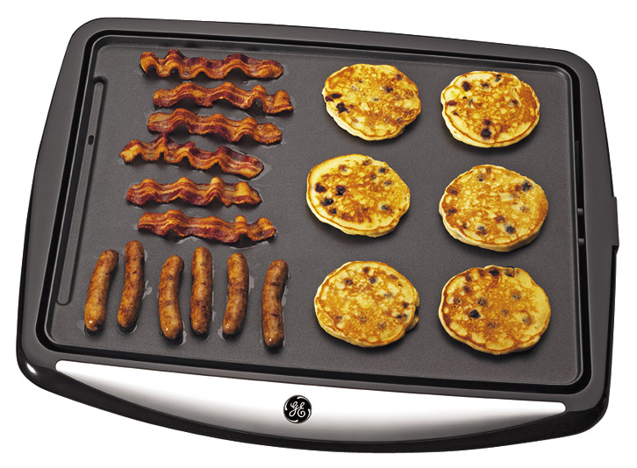
PCB Assembly Methods
Pay Someone
  Can be pricy
Solder it yourself
  Hand solder everything
  Griddle/Toaster oven
    Do not use griddle for food after using it for soldering

Slide 14
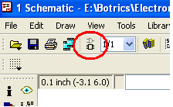
Circuit Board Layout
Place components
Create Electrical connections between them
Ensure that your board isn’t impossible with current PCB fab robots
The magic button -------→
  Logical becomes physical

Slide 15
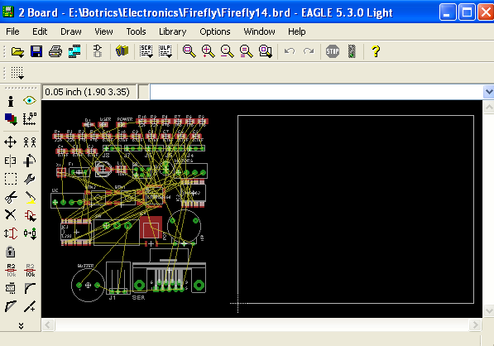
The Layout Screen

Slide 16
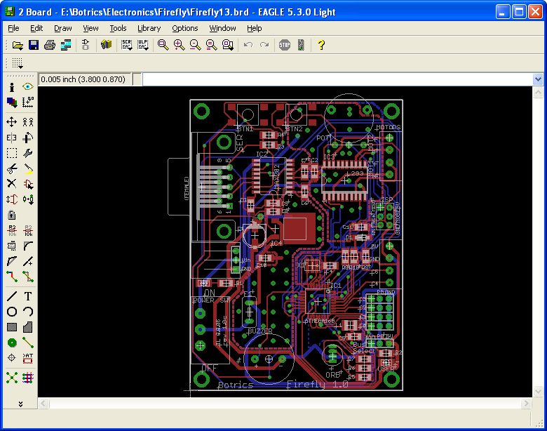
A Fully Routed Board

Slide 17
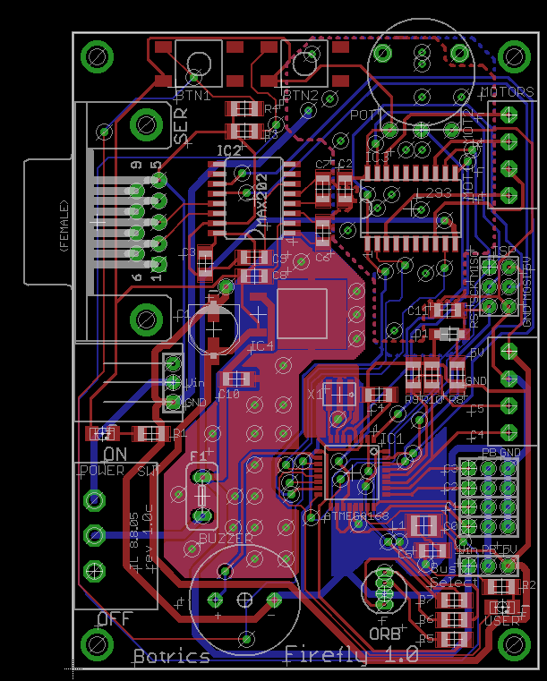
Layers
Like an onion, right?
Copper in red and blue
  Around holes it’s in green
Designators in white
Holes marked with x’s

Slide 18
The DRC (Design Rule Checker)
Design Rules - Thou shalt nots for your circuit board
Adjustable, but…they come from reality:
  Advanced Circuits Capabilities
Generally you should set these first
Defaults are fine for the mini-gadget assignment

Slide 19
Placing Components
Move and rotate
Mirror to place on bottom of board
2D representation of a 3D part
  Keep in mind potential spatial conflicts
Orientation and placement may be important, especially for connectors

Slide 20
Routing
The process of making electrical connections between the different components.
The physical (copper) representation of the nets created in your schematic.
Your frenemy, the autorouter
  Computers do the darnedest things
  Fixing things may take as long as routing by hand
Routing by hand creates a much cleaner looking design

Slide 21
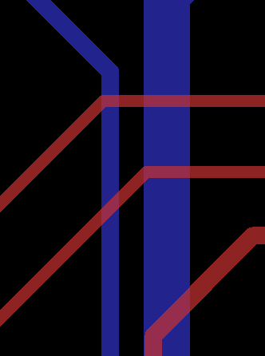
Trace widths
Car jumper cables vs. christmas lights
Some traces need to be bigger than others
  Wider traces carry more current (necessary for driving high-current devices like motors).
  Thin trace carrying lots of current = FIRE
  Wider traces have less noise (good for sensor signals)
Handy tool

Slide 22
Time for the Eagle Tutorial
Set DRC
Move and place parts
Route by hand
Autorouter
Move and place designators

Slide 23
What this Presentation Covers:
What is a Printed Circuit Board
  Where did they come from?
  What are they made of?
  How are they made?
  Compare to wire-wrapped ugliness
Board Layout
  Understanding DRC
    What the numbers mean
    Where they come from (4pcb.com / capabilities.htm)
    When to modify them
  Trace widths
    What the numbers mean
    Where do they com from (pcb trace width calculator)
    When to modify them
Custom Libraries
  Adding parts not already available
  Tweaking/fixing downloaded parts
  Custom graphics/images
Surface Mount
  Shapes and sizes
    Modest
    Tiny
    Dubious (‘SMD DIP’)
  Why does everyone use it?
    Smaller
    Cheaper
    Some components are only SMT

